Slide 1
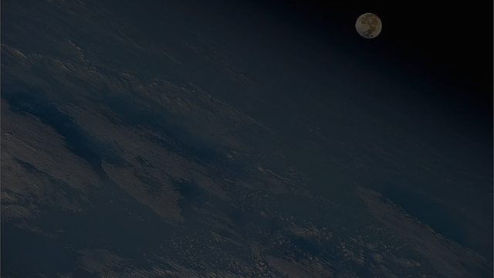


MBSE Avionics System Capstone
Final Demonstration
Shawn
B.S. Electrical Engineering, Aerospace Systems
Luke
B.S. Software Engineering
Clay
B.S. Software Engineering
Walter
B.S. Computer Science, Cybersecurity
Kathryn Wesson
Customer - Embry-Riddle Prescott COE, Dassault Systemes
Notes:
Shawn

Slide 2
Presentation Overview
Introduction
Design Considerations
System Architecture
Live Demo
System Design
Project Process
Notes:
Shawn

Slide 3
Introduction - Background
NASA is working on Gateway, a new lunar space station
Documentation can be a challenge with
Increasing requirements
Bigger team size
Systems with subsystem
Complicated documentation can lead to miscommunications
Which can cause the failure of an entire mission.
How do we keep bad documentation from endangering a project?
Clay
Notes:
At bottom the problem that we’re really trying to solve is how to organize extremely large systems engineering projects such as Gateway. Model-based systems engineering provides one possible solution which we are exploring in our project.

Slide 4
Introduction - Conceptual Problem
NASA is looking for something that can:
Standardize documentation
Identify possible faults in the design
Improve safety and reliability of the system
Allow for multiple divisions to make changes
Our team’s task is to investigate one possible solution to this problem: Model Based Systems Engineering (MBSE)
Clay
Notes:
Really the end goal of our project is to explore, develop, and document a way in which we can improve the safety and reliability of the Gateway system. They want to do this using model-based systems engineering. The system that we are modeling is a conceptual design of a system. We are studying the method, NASA is actually doing it.

Slide 5
Introduction - What is MBSE?
A system lifecycle methodology
Only has one “model”
Contains all documentation and design documents
Traceability between all parts
MagicDraw, created by Dassault
MBSE workflow tool
Shows multiple levels of abstraction
Designed to allow for scalability and refactoring of large systems
Clay
Notes:
Really the end goal of our project is to explore, develop, and document a way in which we can improve the safety and reliability of the Gateway system. They want to do this using model-based systems engineering. The system that we are modeling is a conceptual design of a system. We are studying the method, NASA is actually doing it.

Slide 6

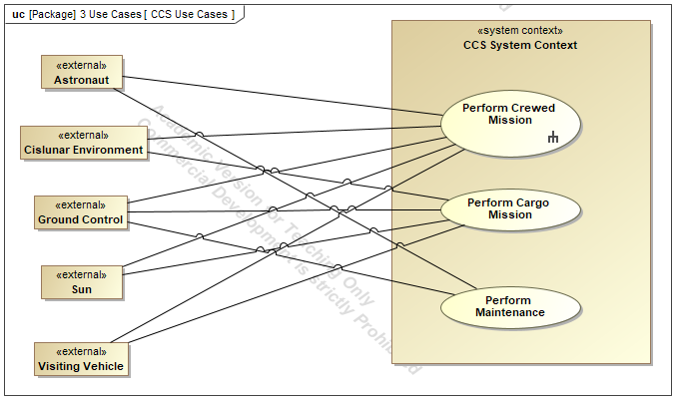

Introduction - MBSE Example
Design Information
System Inquiry
Space Station
System Model
Conflicts
Analysis Report
Design Engineer
Stakeholder
Abstracted View
Proposed Changes
Mechanical
Team
Aerospace Team
Electronics Team
Clay
Notes:
Really the end goal of our project is to explore, develop, and document a way in which we can improve the safety and reliability of the Gateway system. They want to do this using model-based systems engineering. The system that we are modeling is a conceptual design of a system. We are studying the method, NASA is actually doing it.

Slide 7
Introduction - Why Model-Based Systems Engineering?
Traditionally, all changes must be manually updated in all related documents
Large chance of errors
Stakeholder Needs Document
Document-Based:
Change Required
Update
accordingly
Repeat for ALL documents…
Subsystem Structural Design Document
Subsystem
Requirements Document
Clay

Slide 8
Introduction - Why Model-Based Systems Engineering?
In MBSE, every change/modification propagates
Largely mitigates the resources/time required for changes
Subsystem
Requirements Document
Stakeholder Needs Document
System
Model
Subsystem Structural Design Document
Subsystem Behavioral Design Document
Requirements Traceability Document
Clay

Slide 9
Introduction - Our Project
Derive NASA’s current requirements for Gateway
Model our own generalized space station system
Can we show that MBSE is the solution for NASA’s problem?
Do any design errors exist in the current state?
Do any requirements conflict?
Which subsystems need redundancy for safety?
Clay

Slide 10
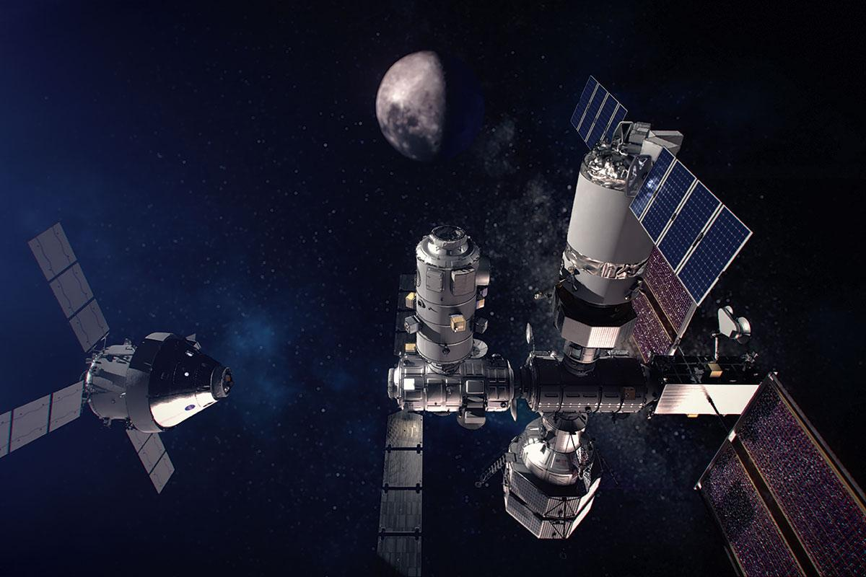
Customer/Project Requirements
Crewed Station
Gateway Mission Alignment
Do we capture the SoI?
MagicGrid Process Compliance
Do we follow the MagicGrid framework?
FMEA Process Compliance
Are we performing FMEA correctly?
Luke
Notes:
We’ve defined the system in SysML and built a system model. We’ve produced a model of this conceptual system in order to support FMEA.

Slide 11
System Architecture
Shawn

Slide 12
System Architecture - Scope of Conceptual Model
Conceptual
Logical
Physical
Flight Computer
Antenna
Rocket Engine
…
2 flight computers
3 antennas
2 rocket engines
…
Level of Abstraction
Design Maturation
Shawn
Notes:
Our system architecture should be the system context diagram and the subsystem diagrams. Clip parts of the MagicGrid index to show the flow from one part to another

Slide 13
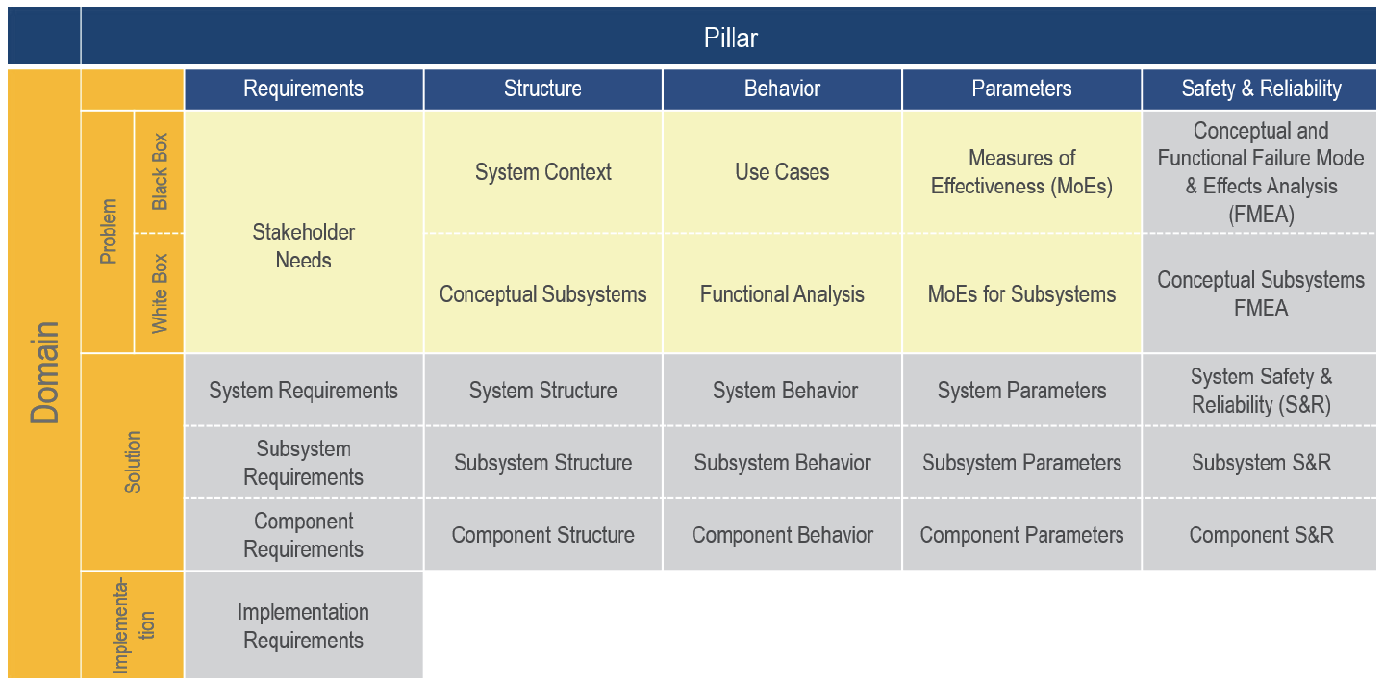
System Architecture - Scope of Conceptual Model
Shawn
Notes:
Our system architecture should be the system context diagram and the subsystem diagrams. Clip parts of the MagicGrid index to show the flow from one part to another

Slide 14
System Architecture - Scope of Conceptual Model
Black Box:
Stakeholder Needs
System Context
Use Cases
Measures of Effectiveness
White Box:
Functional Analysis
Conceptual Subsystems
Subsystem Measures of Effectiveness
Conceptual FMEA
Shawn
Notes:
Our system architecture should be the system context diagram and the subsystem diagrams. Clip parts of the MagicGrid index to show the flow from one part to another

Slide 15
Traceability Live Demo
Luke
Notes:
Luke

Slide 16

Notes:
Luke

Slide 17
Problem Domain
(Black Box)

Slide 18
Black Box
Stakeholder Needs
White Box
System Context
Conceptual Subsystems
Use Cases
MoEs
Functional Analysis
Subsystem MoEs
System FMEA
Subsystem FMEA
Walter
Notes:
Go into detail about black box/white box and explain our various diagrams.

Slide 19
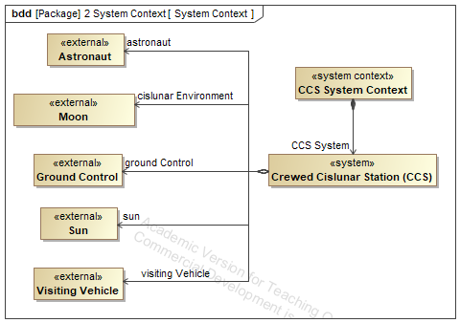
System Context Diagram
Walter
Notes:
Go into detail about black box/white box and explain our various diagrams.

Slide 20
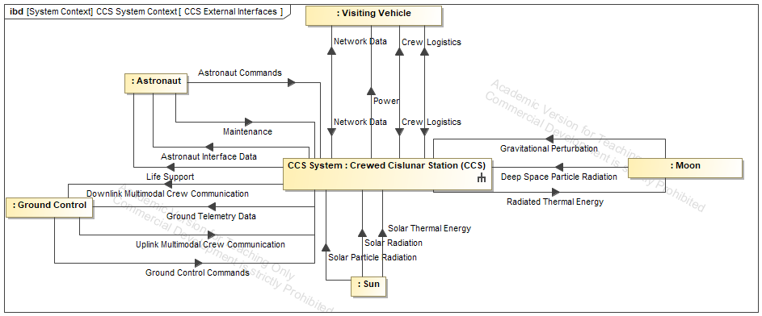
System External Interface Diagram
Walter
Notes:
Go into detail about black box/white box and explain our various diagrams.

Slide 21
Black Box
Stakeholder Needs
White Box
System Context
Conceptual Subsystems
Use Cases
MoEs
Functional Analysis
Subsystem MoEs
System FMEA
Subsystem FMEA
Luke
Notes:
Go into detail about black box/white box and explain our various diagrams.

Slide 22
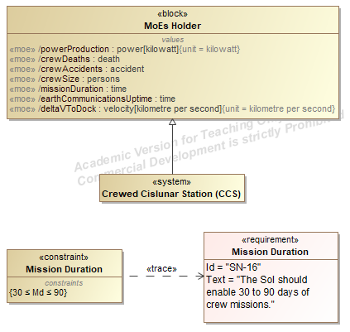
MoEs
The relationship between the constraint and the MoE defines success criteria
Luke
Notes:
Measures of effectiveness are how we actually measure success of the system.

Slide 23
MoEs
Drives the identification of a
Measure of Effectiveness for the system
The relationship between the constraint and the MoE defines success criteria
Luke
Notes:
Measures of effectiveness are how we actually measure success of the system.

Slide 24
Problem Domain
(White Box)

Slide 25
Black Box
Stakeholder Needs
White Box
System Context
Conceptual Subsystems
Use Cases
MoEs
Functional Analysis
Subsystem MoEs
System FMEA
Subsystem FMEA
Walter
Notes:
Go into detail about black box/white box and explain our various diagrams.

Slide 26
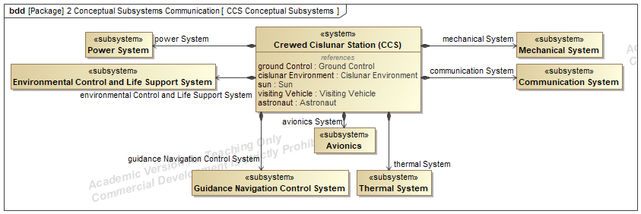
Conceptual Subsystems
Walter
Notes:
Go into detail about black box/white box and explain our various diagrams.

Slide 27
Conceptual Subsystems
Walter
Notes:
Go into detail about black box/white box and explain our various diagrams.

Slide 28
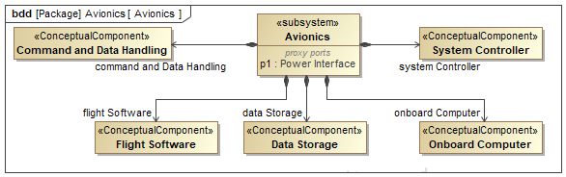
Conceptual Components
Walter
Notes:
Go into detail about black box/white box and explain our various diagrams.

Slide 29
Black Box
Stakeholder Needs
White Box
System Context
Conceptual Subsystems
Use Cases
MoEs
Functional Analysis
Subsystem MoEs
System FMEA
Subsystem FMEA
Walter
Notes:
Go into detail about black box/white box and explain our various diagrams.

Slide 30
Conceptual FMEA
1. Identify Failure
Antenna Power Failure
2. Trace Failure
System Requirements
Power Subsystem
4. Improve Design
Redundant power
3. Generate Requirements
Walter
Notes:
Go into detail about black box/white box and explain our various diagrams.

Slide 31
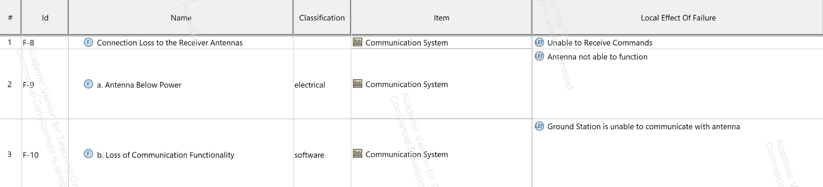
Conceptual FMEA
Failure Item at the System Level
Walter
Notes:
Go into detail about black box/white box and explain our various diagrams.

Slide 32
Conceptual FMEA (Continuation)
Possible ways the high level failure can happen
Walter
Notes:
Go into detail about black box/white box and explain our various diagrams.

Slide 33
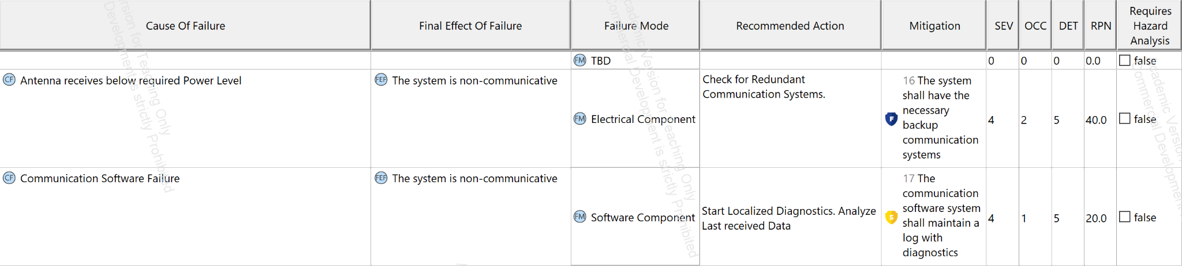
Conceptual FMEA
More information on the failure
Walter
Notes:
Go into detail about black box/white box and explain our various diagrams.

Slide 34
Conceptual FMEA
Risk Analysis
Walter
Notes:
Go into detail about black box/white box and explain our various diagrams.

Slide 35
Project Process

Slide 36
Product Validation
Model Mission Alignment
MagicGrid Process Compliance
FMEA Process Compliance
Spoke with NASA SWEs
Referenced NASA Documents
MagicGrid BoK
Customer review
Dassault Systemes Guide
Customer review
Shawn

Slide 37
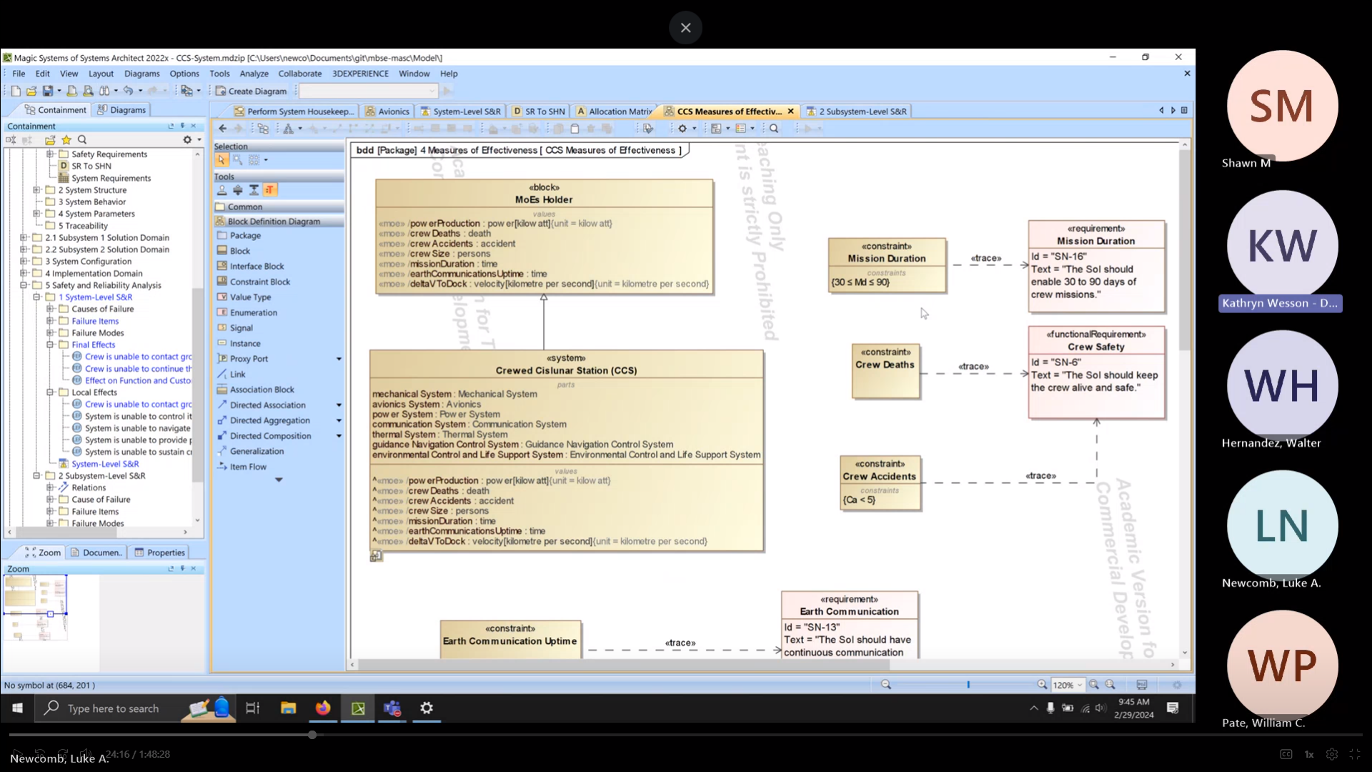
Lessons Learned
System modelling is a high overhead and reward endeavour
Having a framework available is essential for success
Review and consultation with a Subject-Matter Expert (SME) is the best monitoring method
Teams Meeting Recording with SME for model review
Shawn

Slide 38

Thank you!
Any Questions?

